Slide 1
FLOW NETWORK
SUJAL LUHAR
PRIYANSH DAHAKE

Slide 2
Introduction:
Ford Fulkerson is the algorithm to find maximum flow in the network.
It was using DFS traversals
Then Edmond-Karp introduced BFS variant of ford-Fulkerson
Which will make the algorithm’s runtime independent from max flow value
Ford Fulkerson with DFS: O(Ef)
Ford Fulkerson with BFS: O(E^2*v)

Slide 3
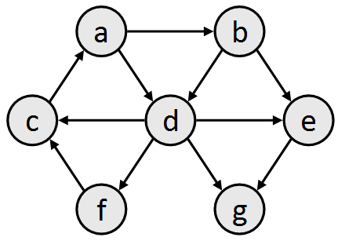
BFS:
v
u
v
a | b | d | e | c | f | g

Slide 4
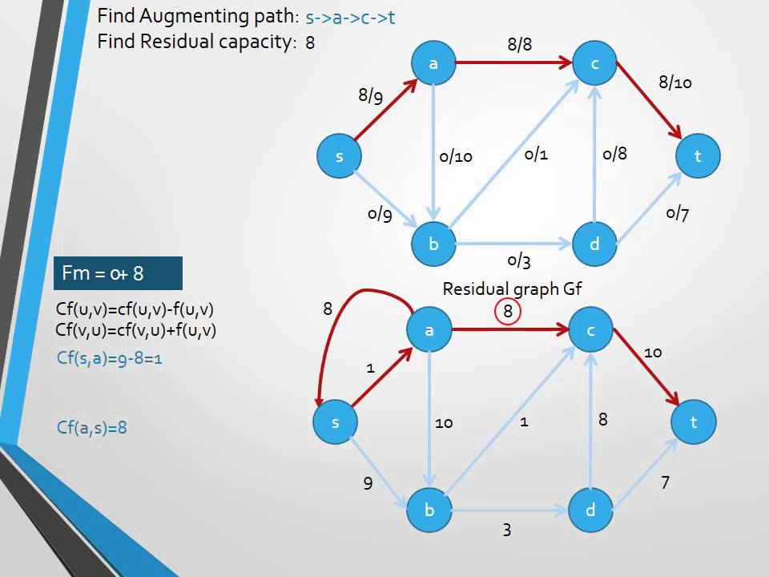
Ford-Fulkerson:

Slide 5
Applications:
Water networks
Electric wires

Slide 6


